Slide 1
HOLLY & JAMES
MAY 16TH, 2026
50 GUESTS
CHÂTEAU NAINVILLES-LES-ROCHES

Slide 2
SIGNS / PAPETERIE

Slide 3
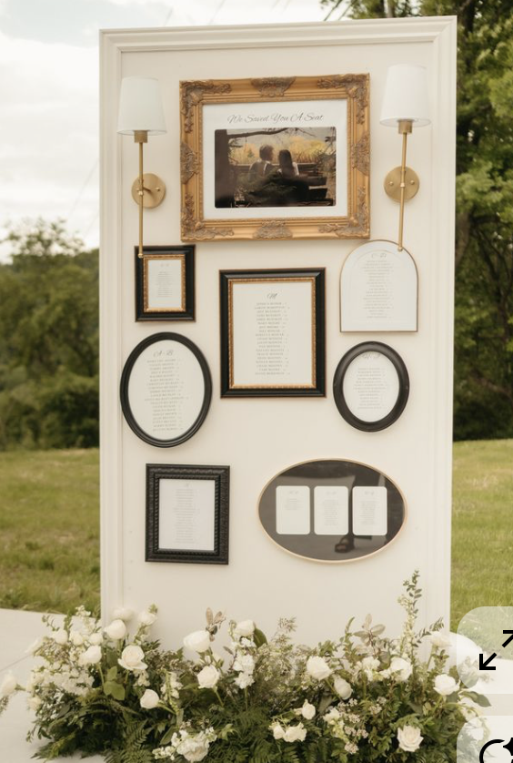
Seating Chart
The seating chart will be designed in an art-gallery style, inspired by the reference image
A medium-sized floral arrangement will be displayed at the base of the seating chart, with décor echoing the reference imagery and styled in harmony with the color palette detailed on slide #2

Slide 4
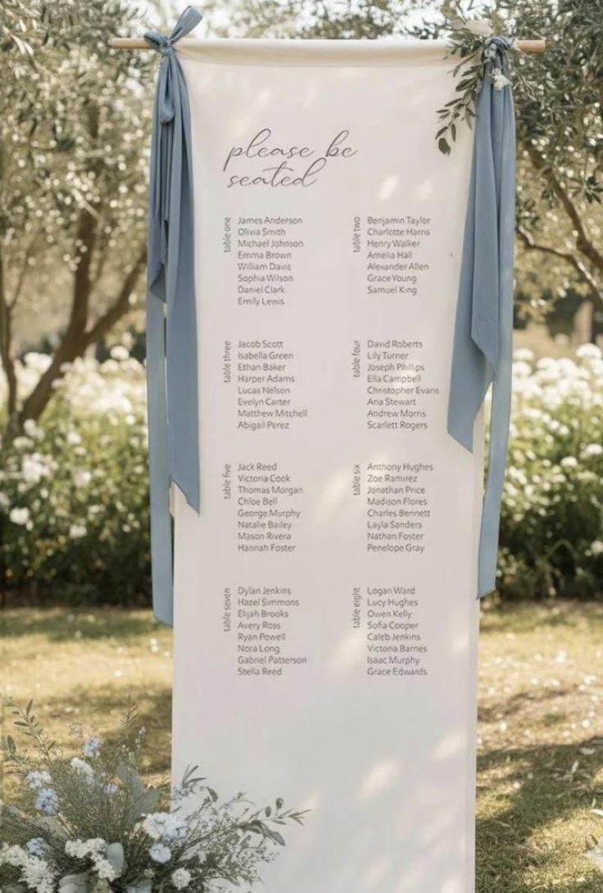
Seating Chart
The seating chart will be designed as picture and with alphabetical order names.

Slide 5
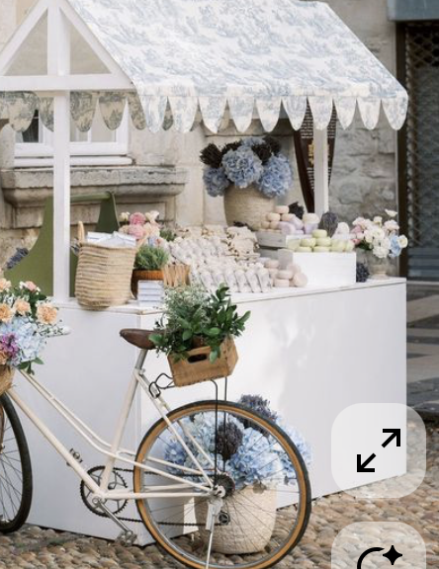
Market shop structure
Nous recherchons ce type de “market” identique ou similaire.

Slide 6
NOTES POUR LE DESIGNER/IMPRIMEUR:
. SEATING CHART OPTION 1
. SEATING CHART OPTION 2

